Slide 1
Basics of C

Slide 2
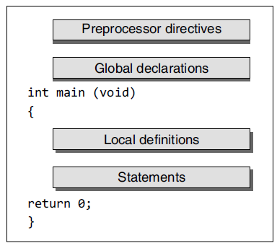
Structure of a C Program

Slide 3
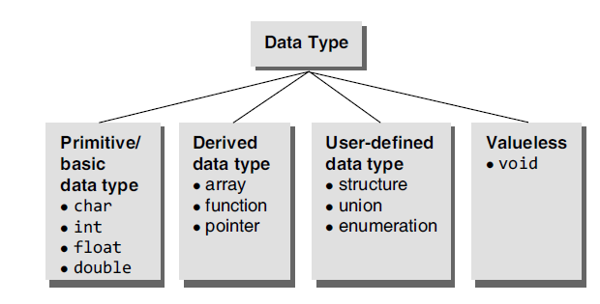
Data types in C

Slide 4
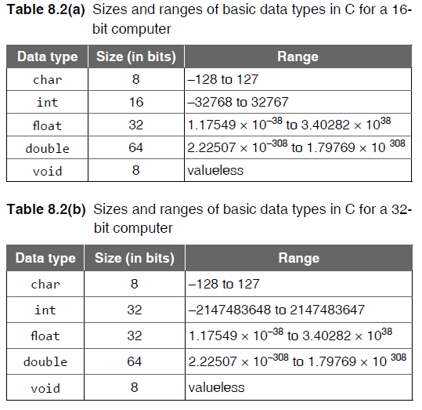
Size of basic data types

Slide 5
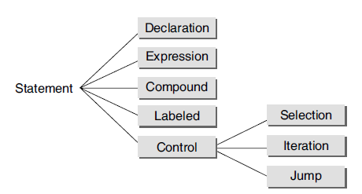
Statements in C

Slide 6
Tokens in C
Identifiers
Separators
Keywords
Operators
Constants

Slide 7
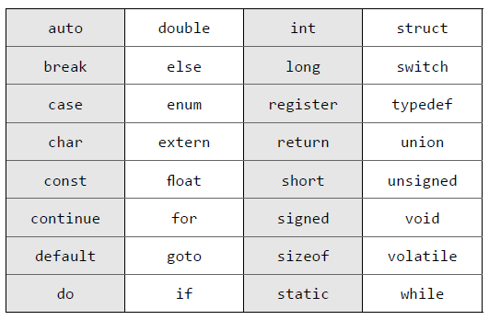
Keywords in C

Slide 8
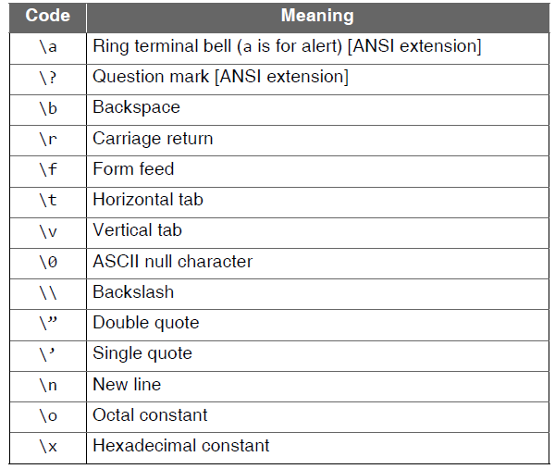
Backslash Codes

Slide 9
Operators in C
Arithmetic
Logical
Relational
Assignment
Equality
Bitwise
Others

Slide 10
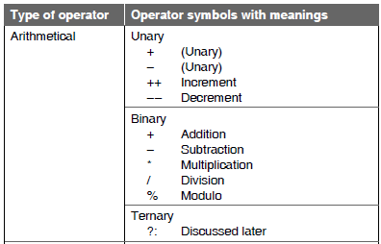
Arithmetic Operators

Slide 11
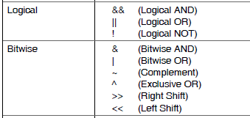
Logical and Bitwise Operators

Slide 12
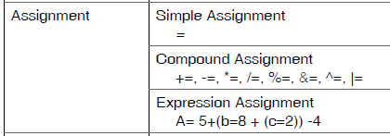
Assignment Operators

Slide 13


Relational, Equality and Other operators

Slide 14
Example
#include <stdio.h>
int main()
{
int a;
int b = 4;
int c = 8;
int d = 2;
int e = 4;
int f = 2;
a = b + c / d + e * f;
/* result without parentheses */
printf(“The value of a is = %d \n”, a);
a = (b + c) / d + e * f;
/* result with parentheses */
printf(“The value of a is = %d \n”, a);
a = b + c / ((d + e) * f);
/* another result with parentheses */
printf(“The value of a is = %d \n”, a);
return 0;
}

Slide 15
Output
The value of a is = 16
The value of a is = 14
The value of a is = 4

Slide 16
I/O Operations
Non-Formatted input/output
getchar();
putchar();
getch();
getche();
Formatted input/output
printf();
scanf();

Slide 17
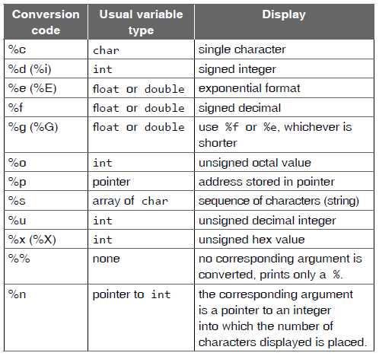
Format Specifiers – printf();

Slide 18
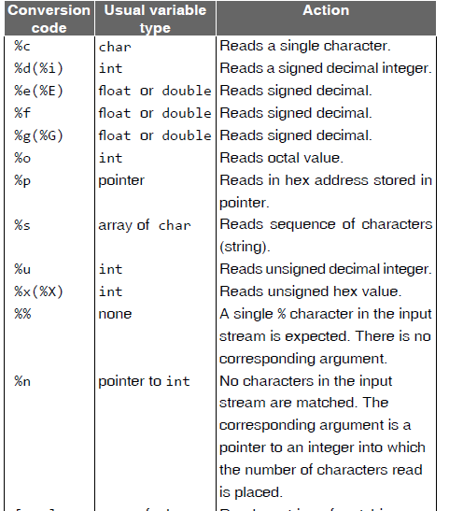
Format Specifiers - scanf();

Slide 19
Branching Statements
if
if and else
if – else if – else
Nested if
switch-case

Slide 20
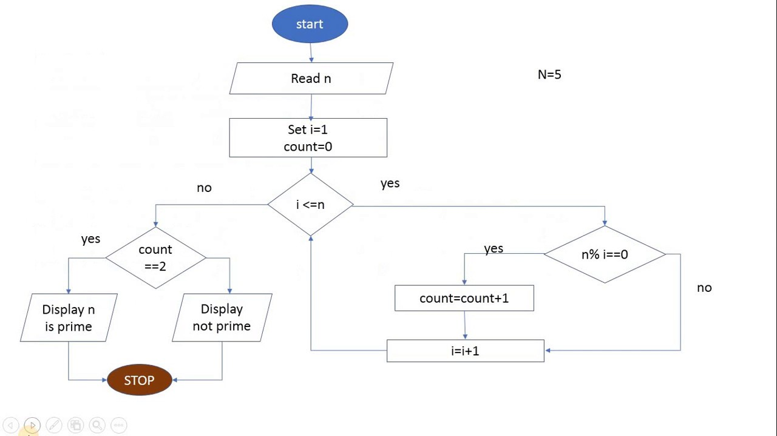
Flowchart for prime

Slide 21
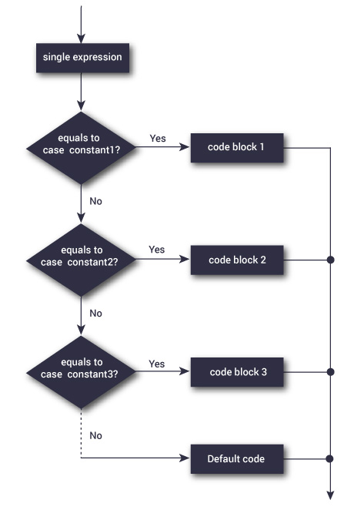
Flowchart for switch case

Slide 22
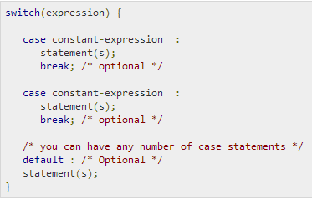
Switch-case syntax

